Slide 1
P286 GROUP-2 Presenting
Book Recommendation System
Presented By:
Mr. Ganesh Sanjay Bhandarkar
Mr. Sandesh Kale
Mr. Saurabh Pathare
Ms. Amruta Gavhane
Ms. Khushi Pradip Gole
Ms. Mufida Khatoon Mohammad Rafique Khan.
Project Mentor:
Ms. Aishwarya Ajay Mate

Slide 2
Business Objective:
Recommendation systems are widely used today to recommend products to users based on their interests. A recommendation system is one of the strongest systems for increasing profits by retaining more users in a very big competition.
Project goal:
To build a recommendation system that will recommend a user top books of his/her interest.

Slide 3
About the dataset Three separate files:
Users: Contains basic information regarding the reader. UserID, Location, Age.
Books: Contains basic information regarding the books. ISBN, Title, Author, Year of publication, Publisher
Rating: Contains all of the user rating information. UserID, ISBN, Rating(1-10) 10 being the highest

Slide 4
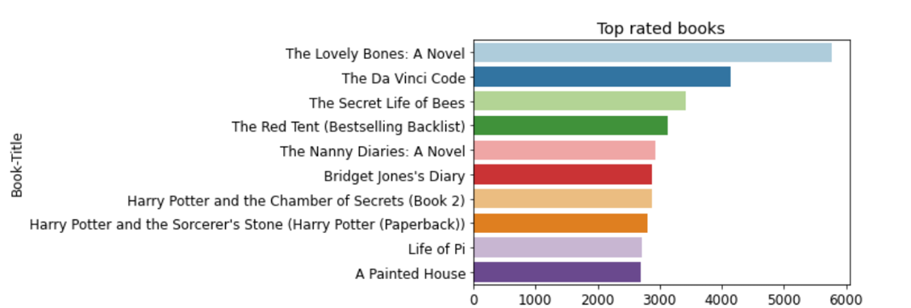
Top Rated Books

Slide 5
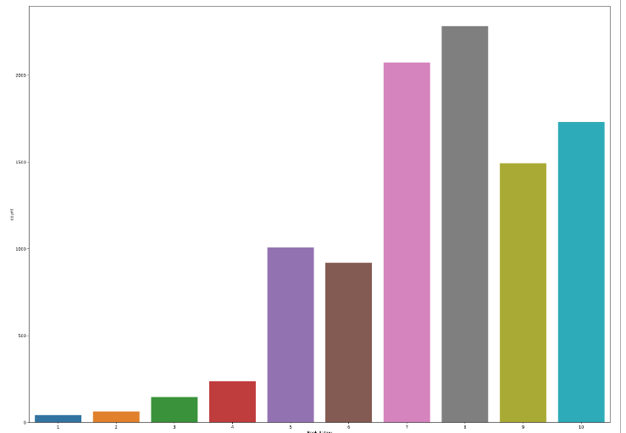
Distribution of Ratings
Average Rating of a book per user is between 7 and 8

Slide 6
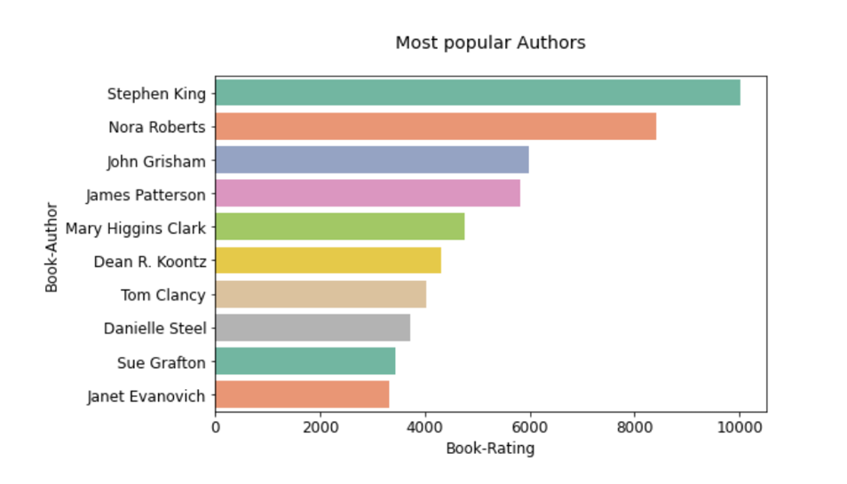
Popular Authors

Slide 7
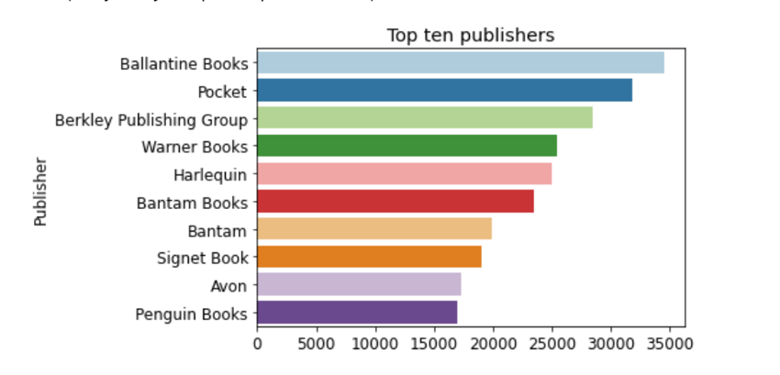
Top Publishers

Slide 8
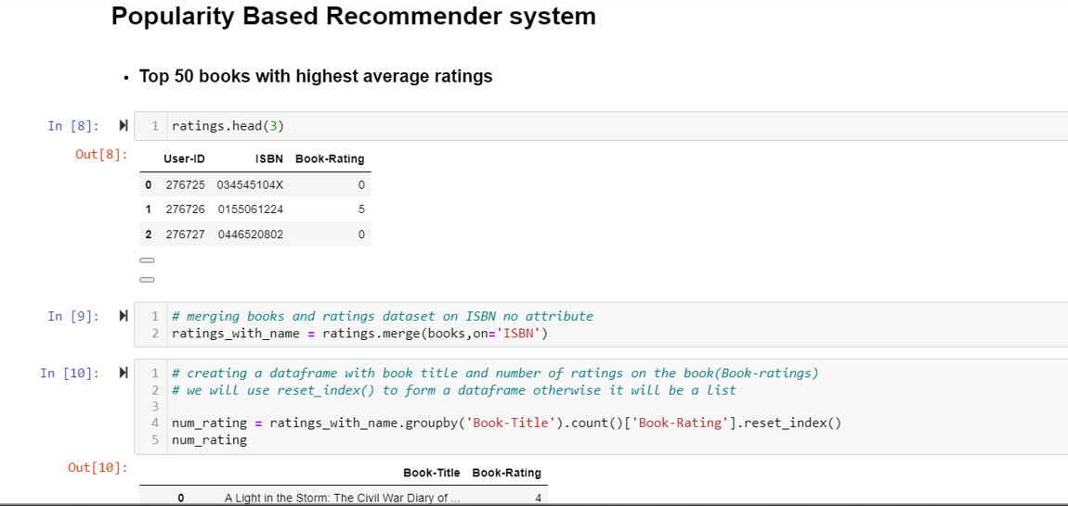

Slide 9
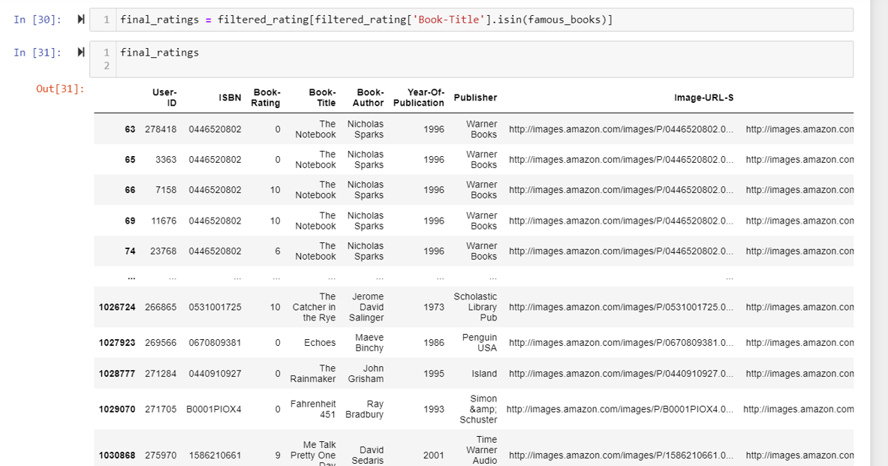

Slide 10
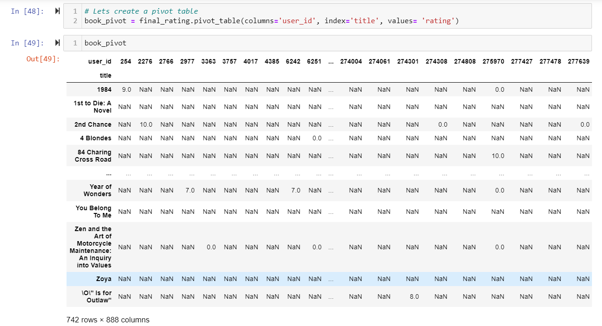

Slide 11
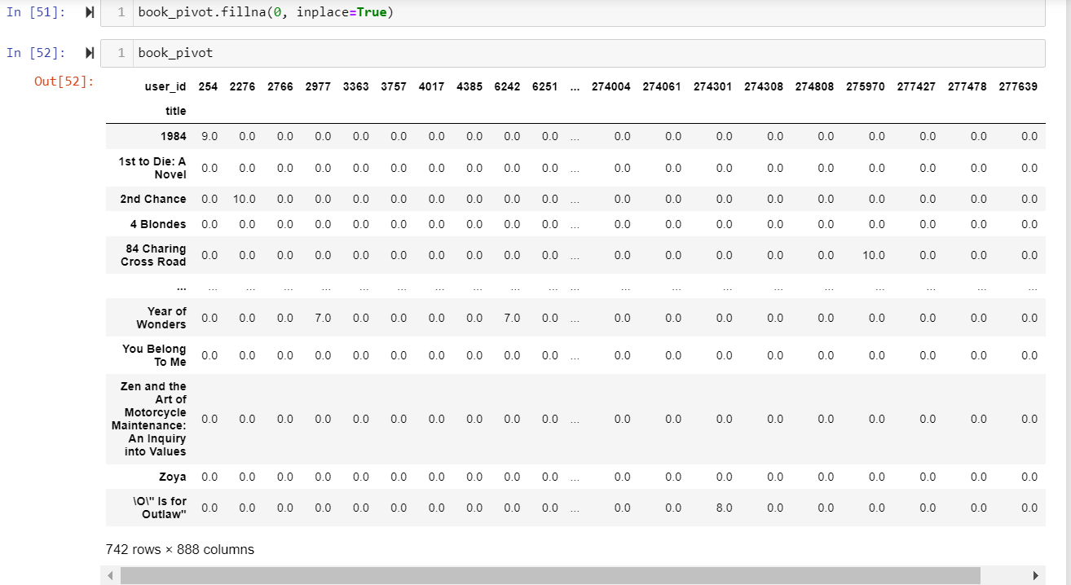

Slide 12
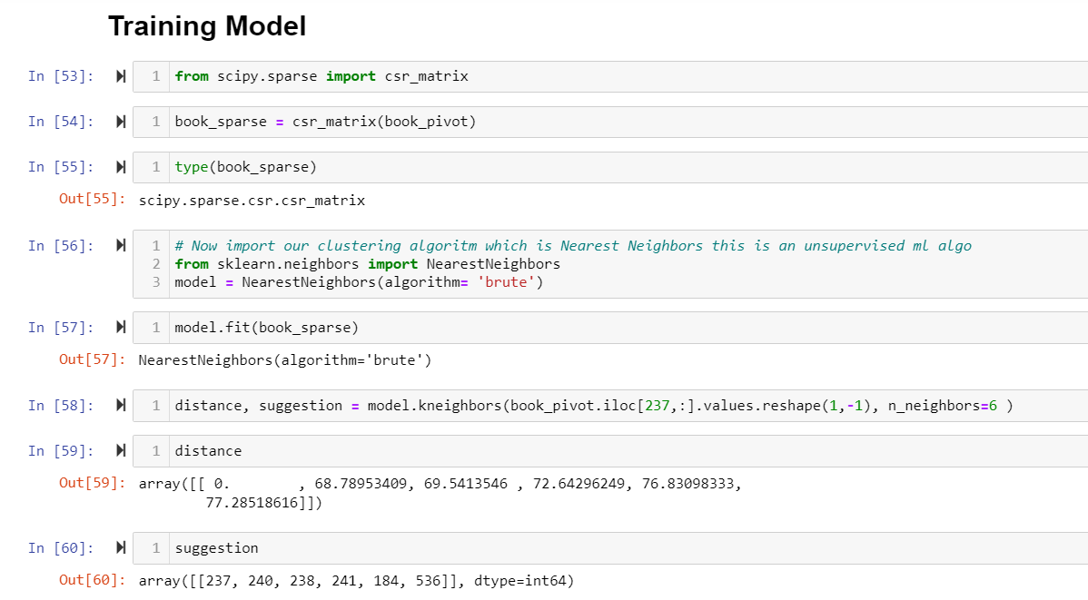

Slide 13
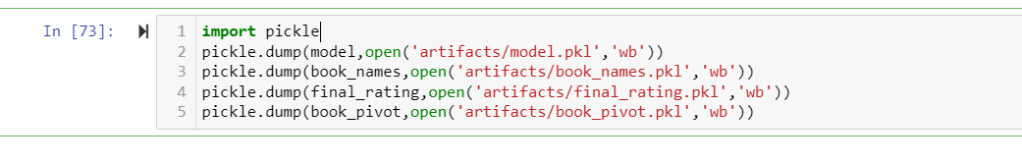

Slide 14
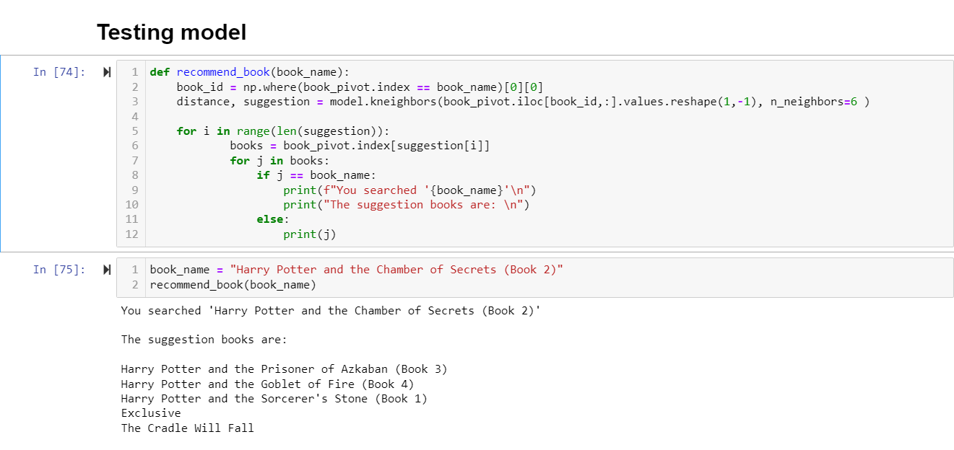

Slide 15
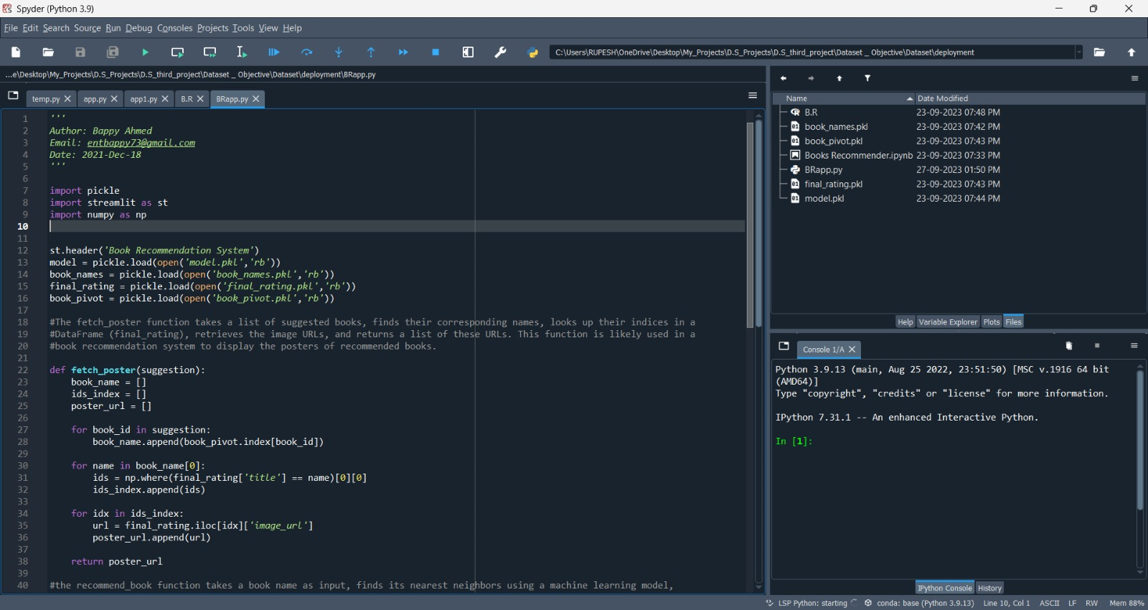

Slide 16
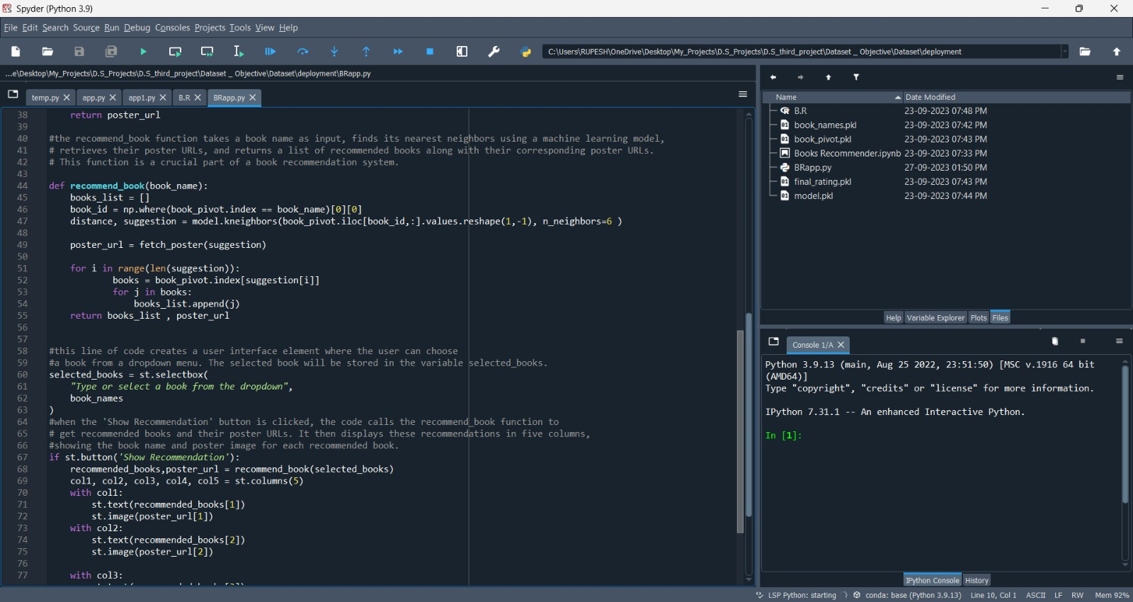

Slide 17
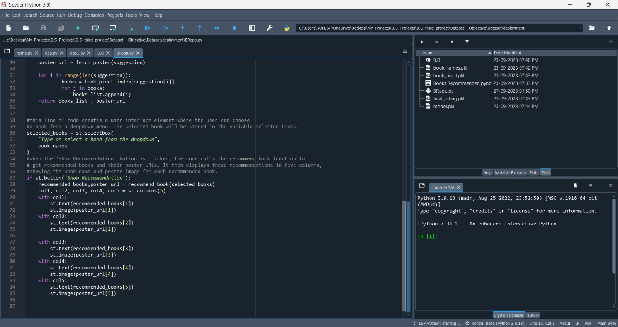

Slide 18
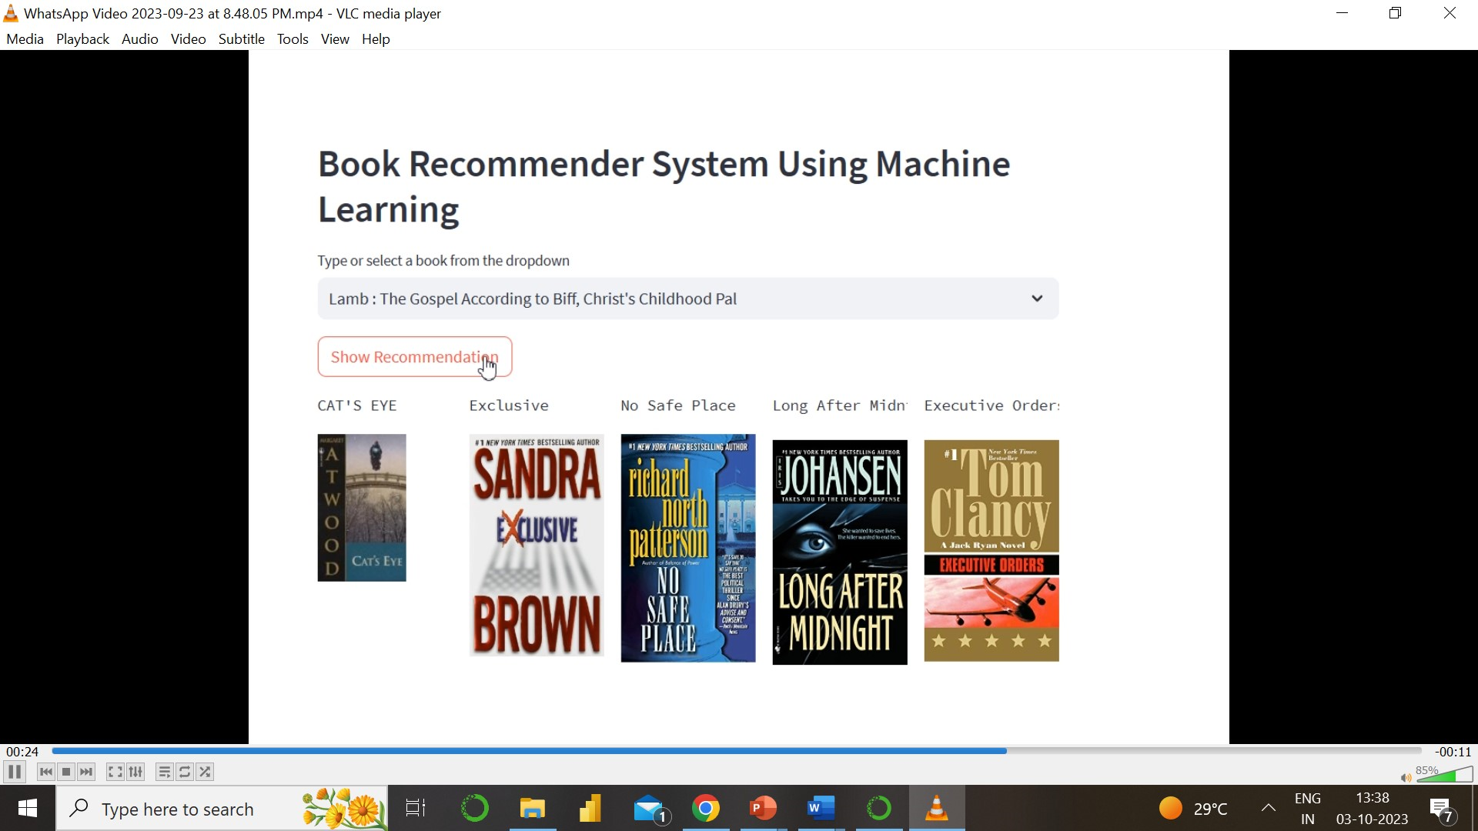

Slide 19
Thank you…

